Slide 1
Supporting Low-income customers
Mark Robertson
Microinsurance Network (MiN)
18 March 2021

Slide 2
The work we do at the MiN
“Through membership and partnerships we bring together the entire inclusive insurance eco-system united by a common vision.”
VISION
MISSION
To promote the development and delivery of effective risk management tools, including insurance services, for unserved people.
A world where people of all income levels are more resilient and less vulnerable to daily and catastrophic risks.
Ultimate outcome: Improved resilience of low-income households & MSMEs

Slide 3
Why we believe in insurance (& takaful)
Supports household resilience and contribute to economic development
Provides the foundation for achieving development goals
Household
Risk transfer
Direct
Zero Hunger
Good health
resilience
Productive risk-taking
and well-being
Peace of mind
Insurance
Access to critical services
Business
Risk transfer
Gender equality
resilience
Risk management
End poverty
Credit market development
Indirect
Capital market
Mobilising capital
Climate action
Decent work and
economic growth
development
Pooling capital
Allocating capital
Building institutions
Source: Adapted from Chamberlain et ai. (2017)
Insurance and takaful achieve similar ends – but through different mechanisms

Slide 4
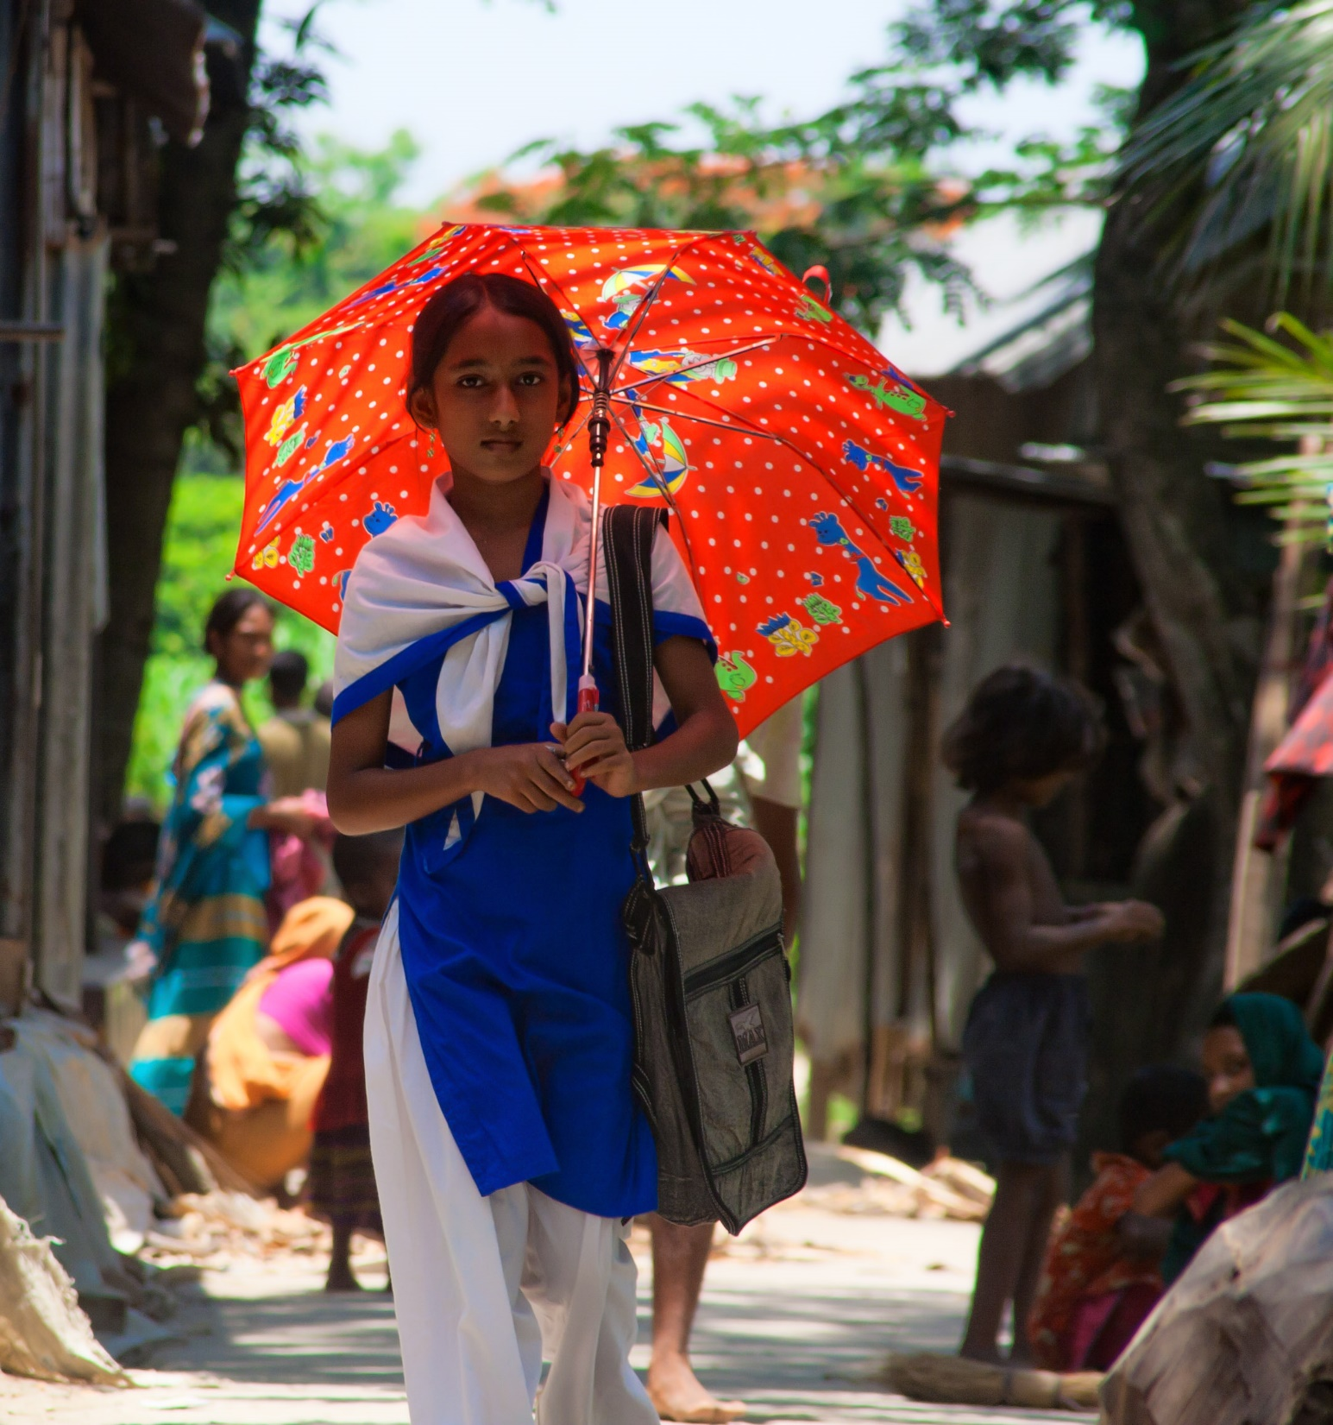
Why microinsurance and microtakaful?
To support financial inclusion
To address the risk mitigation needs of low-income people
Increase resilience to shocks
To help alleviate poverty and achieve the SDGs

Slide 5
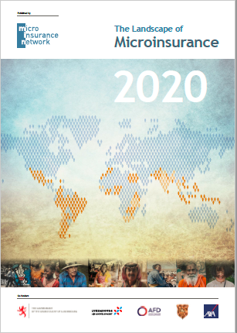
What does the landscape look like? (1/2)
Introduction to the Landscape Study
Track the evolution of microinsurance
Number of lives covered
Premiums
Types of risk covered
Product quality (KPIs)
Drive market development
Identify potential
Identify barriers
Monitoring & evaluation benchmark
Encourage routine collection of data
Customer-centric (lives)
Disaggregated by business line
Segmented by income group

Slide 6
In 2020 we carried out primary research in 30 countries. The report is available in English, French, Spanish, and Arabic
What does the landscape look like? (2/2)
Landscape Study coverage in 2020
2020 LANDSCAPE COUNTRIES
Argentina
Bangladesh
Bolivia
Brazil
Cambodia
Chile
Colombia
Côte d'Ivoire
Egypt
Ghana
India
Indonesia
Jamaica
Kenya
Mexico
Morocco
Nepal
Nigeria
Pakistan
Peru
Philippines
Rwanda
Senegal
South Africa
Sri Lanka
Tanzania
Thailand
Vietnam
Zambia
Zimbabwe

Slide 7
Continued rise of low-cost health products (mostly hospital cash; often used for income lost due to illness)
Shifting perspectives on climate risks, with the importance of government support and building trust through paying claims being evident
Combining digitalisation and human touch: while agents and brokers remained key, the importance of digital increased, with many hybrid models in place. We also noted that financial services form an important part of many non-insurance platforms’ long-term business models
Concerns around customer value, particularly low claims ratios and long claims turnaround times (TATs)
What have we learnt?
Note: xxx
Source: xxx

Slide 8
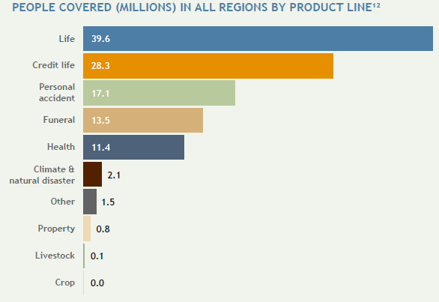
Traditional products still dominate
Note: Across the study’s 194 insurance providers, 41-102M people were recorded as covered by a microinsurance product (est. 5% of microinsurance market value)
Source: MiN Landscape of Microinsurance 2020

Slide 9
Claims performance is a concern
Source: MiN Landscape of Microinsurance 2020

Slide 10
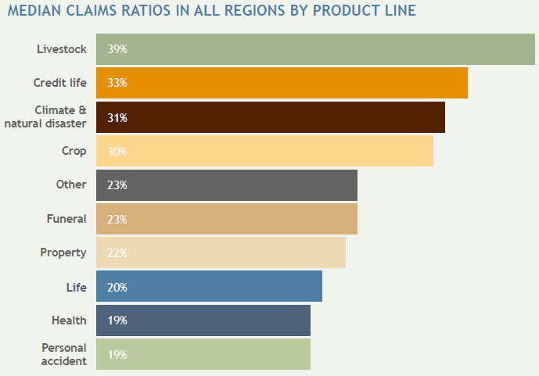
Claims ratios by product differ significantly
Source: MiN Landscape of Microinsurance 2020

Slide 11
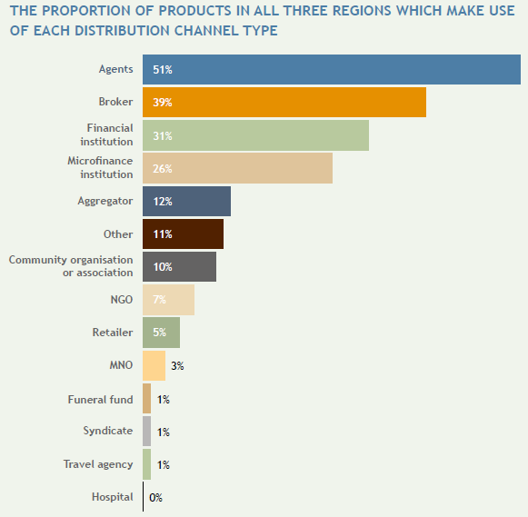
Traditional distribution remains key
Source: MiN Landscape of Microinsurance 2020

Slide 12
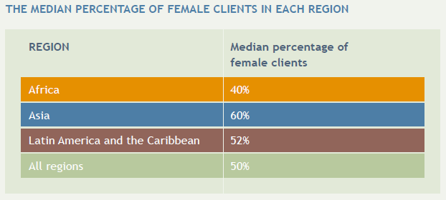
Gender is not widely enough measured
Source: MiN Landscape of Microinsurance 2020

Slide 13
Where to from here?

Slide 14
Microtakaful has growth potential…
Although fragmented, the global Takaful market grew at a CAGR of 18% between 2007 and 2012 and is expected to grow from USD24bn in 2019 to over USD 40bn by 2023.
The global Muslim population is forecasted to increase to 2.2 billion by 2030, at which point an estimated 79 countries will have a million or more Muslims inhabitants.
Most of these are low- or middle-income countries and have low insurance penetration rates, suggesting an opportunity for growth.
Microtakaful’s poverty-reduction role could support (and thus form part of) government/ public social protection schemes.
Sources: Pew Research Center’s forum on Religion and Public Life - The Future of the Global Muslim Population - January 2011; Shaikh, S.A.,Ismail, A. G., & Mohd Shafiai, M. H. (2017). Application of waqf for social and development finance. ISRA International Journal of Islamic Finance, 9(1), 5-14; Bank Negara Malaysia (2016). Discussion paper on micro-insurance and microtakaful. Kuala Lumpur - BNM https://www.bnm.gov.my/-/discussion-paper-on-microinsurance-and-microtakaful; Microtakaful: Field study evidence and conceptual issues Groningen conference paper- https://www.rug.nl/research/globalisation-studies-groningen/research/conferencesandseminars/conferences/eumicrofinconf2011/papers/13.erlbeck-altuntas-berrystolzle.pdf

Slide 15
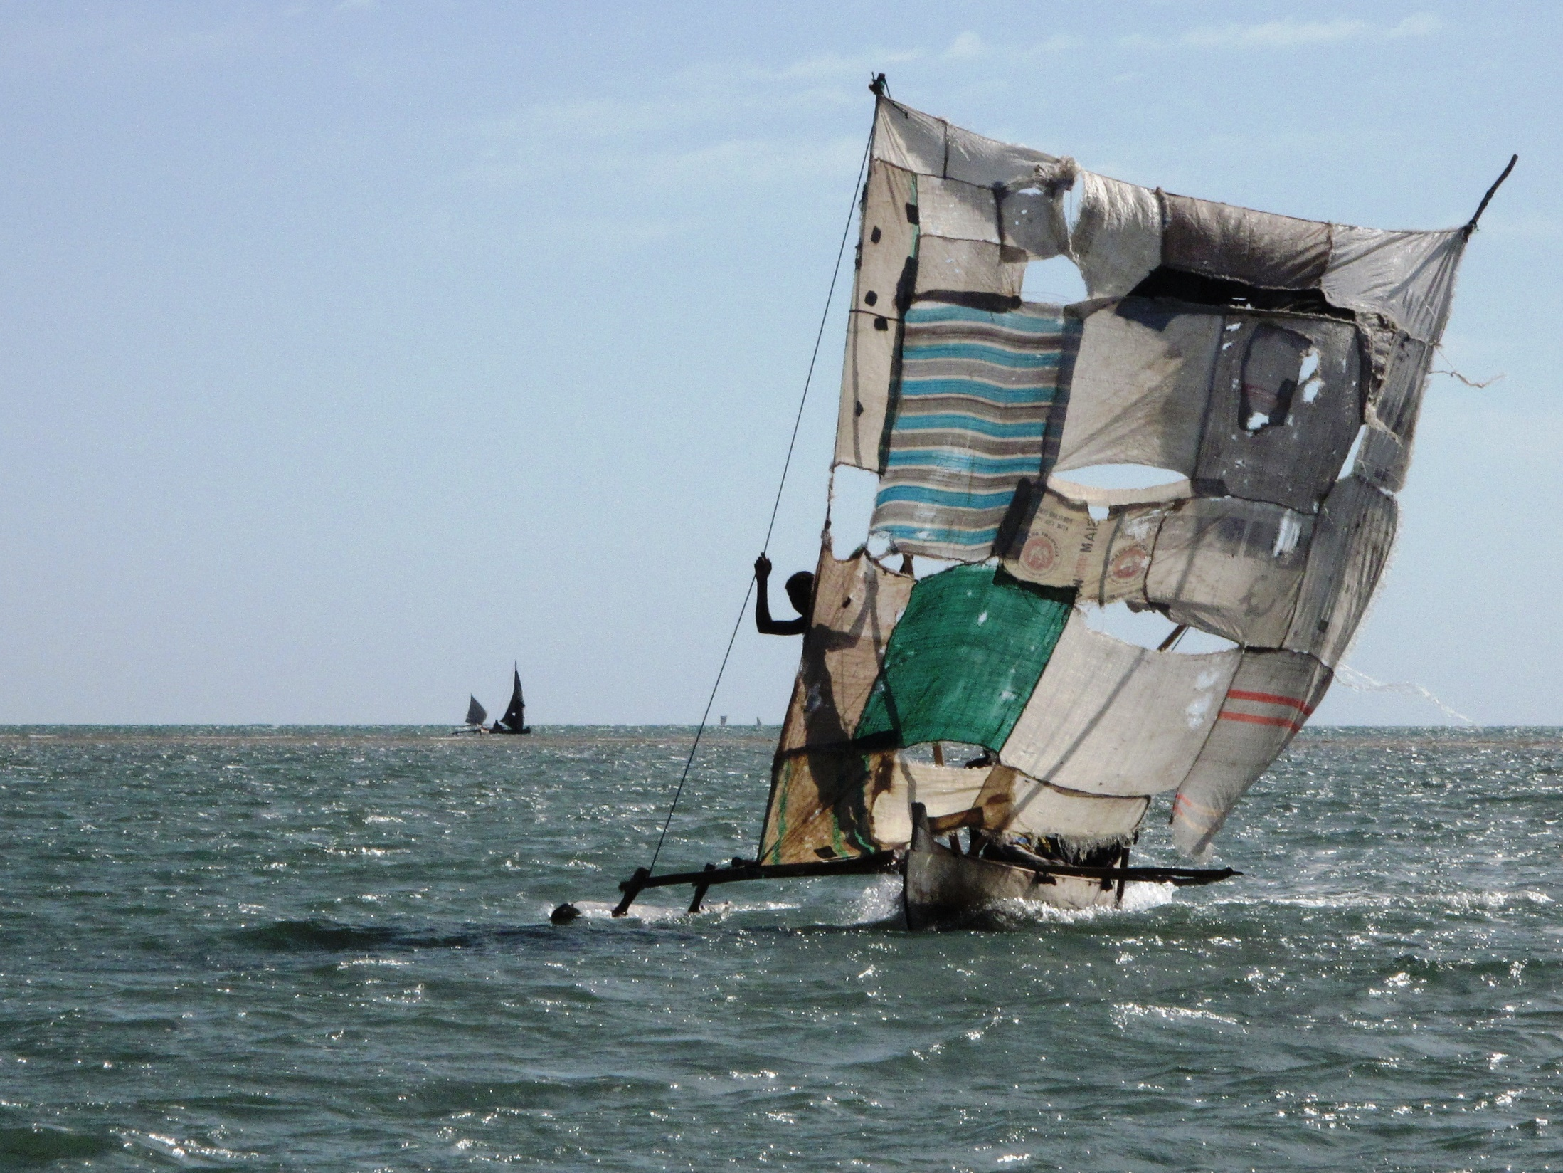
…but it will not be easy…
Shariah-based products are often limited (in type/ design).
In many countries, regulatory inclusion of takaful products is still required.
More region-specific product designs are needed to address needs particular to a region (vs. translating products from elsewhere).
The microtakaful industry lags microinsurance and is contingent on (and overshadowed by) the takaful industry
There is limited microtakaful data available, especially relating to financial inclusion, which hampers growth
Sources: Pew Research Center’s forum on Religion and Public Life - The Future of the Global Muslim Population - January 2011; Shaikh, S.A.,Ismail, A. G., & Mohd Shafiai, M. H. (2017). Application of waqf for social and development finance. ISRA International Journal of Islamic Finance, 9(1), 5-14; Bank Negara Malaysia (2016). Discussion paper on micro-insurance and microtakaful. Kuala Lumpur - BNM https://www.bnm.gov.my/-/discussion-paper-on-microinsurance-and-microtakaful; Microtakaful: Field study evidence and conceptual issues Groningen conference paper- https://www.rug.nl/research/globalisation-studies-groningen/research/conferencesandseminars/conferences/eumicrofinconf2011/papers/13.erlbeck-altuntas-berrystolzle.pdf

Slide 16
…and many challenges remain
Product affordability
Skills availability
Building the right governance and regulatory/ supervisory environments
Reaching scale
Reducing the costs of distribution
Product design
Persistency/ renewals
Education
…

Slide 17
Thank you mrobertson@microinsurancenetwork.org

